Slide 1
JIT Compiler, V8 Engine, And Optimization Tricks
Tamar Twena-Stern

Slide 2


About me
Software engineer – Manager and Architect
Now writing awesome code at bitsrc.io
Former
leader of Edgeverve Development group in Israel, Oecloud.io Architect
CTO at a start up of my own
Performance team leader at NCR

Slide 3
Agenda
The JIT compiler
V8 Engine
JavaScript Code Optimizations

Slide 4
The JIT Compiler

Slide 5
Just-In-Time Compilation Explained
Executing computer code that involves compilation during run time
Combines two approaches :
Ahead of compilation
Interpreter
Notes:
A compilation is performed during runtime

Slide 6
JIT Compiler – Traditional Approach
Usually Combined with Ahead Of Compilation approach (AOT)
Source code is translated to Intermediate representation
Bytecode (Java)
CLI (C#)
Intermediate Representation interpreted by VM
JIT compiler executed
reads intermediate representation in multiple sections
Compiles dynamically into machine code

Slide 7
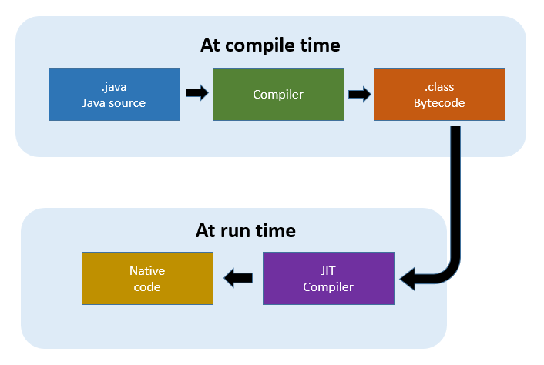
JIT Compiler In Java
Notes:
he Just-In-Time (JIT) compiler is a component of the Java Runtime Environment that improves the performance of Java applications at run time. Java programs consists of classes, which contain platform neutral bytecode that can be interpreted by a JVM on many different computer architectures. At run time, the JVM loads the class files, determines the semantics of each individual bytecode, and performs the appropriate computation. The additional processor and memory usage during interpretation means that a Java application performs more slowly than a native application. The JIT compiler helps improve the performance of Java programs by compiling bytecode into native machine code at run time.
The JIT compiler is enabled by default, and is activated when a Java method is called. The JIT compiler compiles the bytecode of that method into native machine code, compiling it "just in time" to run. When a method has been compiled, the JVM calls the compiled code of that method directly instead of interpreting it. Theoretically, if compilation did not require processor time and memory usage, compiling every method could allow the speed of the Java program to approach that of a native application.

Slide 8
JIT Compiler In JavaScript
Source code
Tracing
Interpreter
Function Repeats
JIT compiler
Baseline Compiler
Function Repeats A Lot !
JIT compiler
Optimized Compiler
Notes:
The JavaScript engine has a phase called ‘Monitoring’.
At first , monitoring pass everything through the interpreter
A tracing is done to count how many times the function is called
When a function is called several times it is defined ‘warm’
When a function is called a lot of times it is defined ‘hot’
JIT compiler start optimizing the function when it is warm

Slide 9
Baseline Compiler
When a function starts to warm, JIT will send it to be compiled.
JIT will store the compilation
Each line of function is compiled to a “stub”
Monitoring/Tracing will pull the compiled version once function is called
Compiled version is not fully optimize
not create runtime overhead
Notes:
When a function starts getting warm, the JIT will send it off to be compiled. Then it will store that compilation.
Each line of the function is compiled to a “stub”. The stubs are indexed by line number and variable type (I’ll explain why that’s important later). If the monitor sees that execution is hitting the same code again with the same variable types, it will just pull out its compiled version.
That helps speed things up. But like I said, there’s more a compiler can do. It can take some time to figure out the most efficient way to do things… to make optimizations.
The baseline compiler will make some of these optimizations (I give an example of one below). It doesn’t want to take too much time, though, because it doesn’t want to hold up execution too long.
However, if the code is really hot—if it’s being run a whole bunch of times—then it’s worth taking the extra time to make more optimizations.

Slide 10
Optimizing Compiler
When a code is hot – it is worth doing multiple optimizations
Tracing will send it to optimizing compiler
Creates an even faster version of the code
Tracing pulls it when the function code runs
Notes:
When a part of the code is very hot, the monitor will send it off to the optimizing compiler. This will create another, even faster, version of the function that will also be stored.
In order to make a faster version of the code, the optimizing compiler has to make some assumptions.
For example, if it can assume that all objects created by a particular constructor have the same shape—that is, that they always have the same property names, and that those properties were added in the same order— then it can cut some corners based on that.
The optimizing compiler uses the information the monitor has gathered by watching code execution to make these judgments. If something has been true for all previous passes through a loop, it assumes it will continue to be true.

Slide 11
Optimization And De-Optimization
Optimization - All assumptions fulfilled – Compiled code runs.
Deoptimization – Not all assumptions fulfilled – Compiled code erased
Assumptions Fulfilled
Optimization
Assumptions Break
Deoptimization
Notes:
But of course with JavaScript, there are never any guarantees. You could have 99 objects that all have the same shape, but then the 100th might be missing a property.
So the compiled code needs to check before it runs to see whether the assumptions are valid. If they are, then the compiled code runs. But if not, the JIT assumes that it made the wrong assumptions and trashes the optimized code.
Then execution goes back to the interpreter or baseline compiled version. This process is called deoptimization (or bailing out).

Slide 12
Avoid Deoptimization
When a code is optimized and deoptimized – it ended up being slower then just use the baseline compiled version
Most browsers and engines will stop trying after several iterations of optimizing and deoptimizing
Notes:
Usually optimizing compilers make code faster, but sometimes they can cause unexpected performance problems. If you have code that keeps getting optimized and then deoptimized, it ends up being slower than just executing the baseline compiled version.
Most browsers have added limits to break out of these optimization/deoptimization cycles when they happen. If the JIT has made more than, say, 10 attempts at optimizing and keeps having to throw it out, it will just stop trying.

Slide 13

Chrome V8

Slide 14
Chrome V8
Open source JavaScript engine
Developed originally for Google Chrome and chromium
Also used for
Couchbase
MongoDB
Node.js

Slide 15
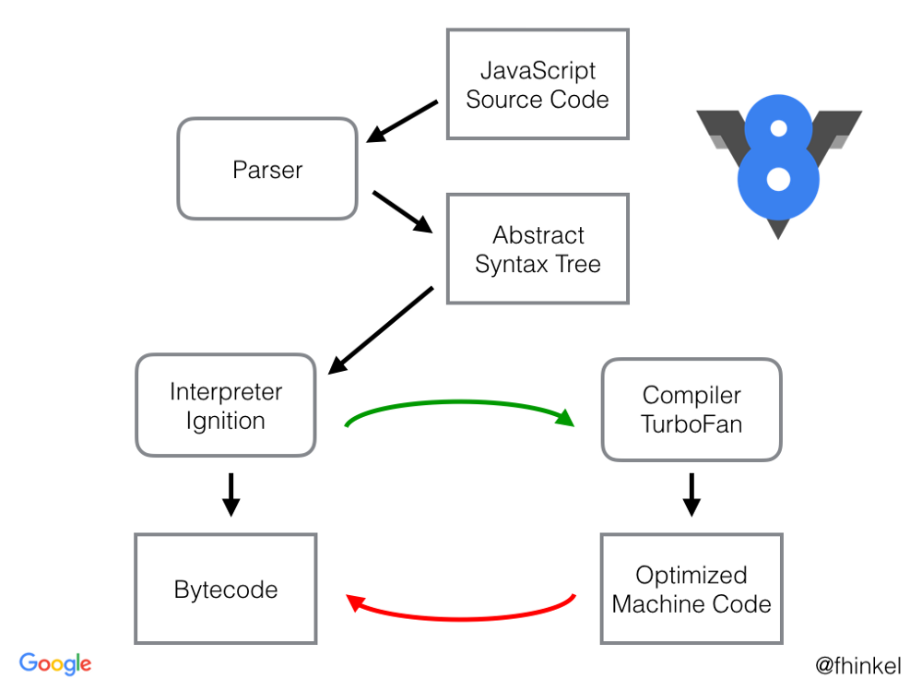
V8 Architecture
Notes:
When V8 compiles JavaScript code, the parser generates an abstract syntax tree. A syntax tree is a tree representation of the syntactic structure of the JavaScript code. Ignition, the interpreter, generates bytecode from this syntax tree. TurboFan, the optimizing compiler, eventually takes the bytecode and generates optimized machine code from it.

Slide 16

Ignition Interpreter
Interpreter for V8
Translates to low level bytecode
Enabling the following code to be stored more compactly in bytecode
Run once code
Non hot code
Notes:
The aim of the Ignition project is to build an interpreter for V8 which executes a low-level bytecode, thus enabling run-once or non-hot code to be stored more compactly in bytecode form. Since the bytecode is smaller, compilation time is much reduced, and we will also be able to be more eager about initial compilation, which significantly improve startup time. An added advantage is that the bytecode can be fed into a Turbofan graph generator directly, thereby avoiding the need to reparse the JavaScript source code when optimizing a function in TurboFan.

Slide 17
Turbofan Compiler
Uses advanced techniques to make hot code run as fast as possible
Relies on input type information collected via inline caches while functions run via the Ignition interpreter.
Generates the best possible code handling the different types it encountered
The fewer function input type variations the compiler has to consider, the smaller and faster the resulting code will be

Slide 18
How To Help Turbofan Optimize Hot Code ?
The fewer function input type variations lead to smaller and faster the resulting code.
Keeping your functions monomorphic or at least polymorphic
Monomorphic: one input type
Polymorphic: two to four input types
Megamorphic: five or more input types

Slide 19
JavaScript Code Optimizations

Slide 20
For vs forEach() Loops
Use foreach() while iterating on arrays
Prefer not to use the for loop
Foreach() Prevent you from iterating empty elements in the array.

Slide 21
Demo – For vs forEach()

Slide 22
Put Common Code In Functions
Hot Code – function or object which continuously being used
The JIT compiler stores the binary version of a continuously used function or object
If the contract is not changed – v8 will optimize

Slide 23
Demo – Functions Vs Not Using Functions

Slide 24

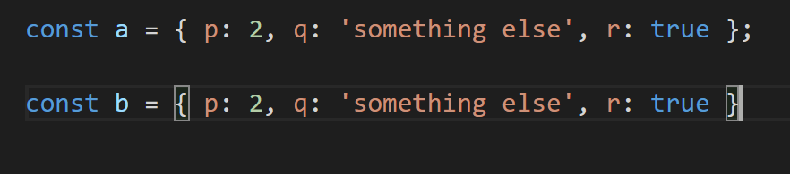

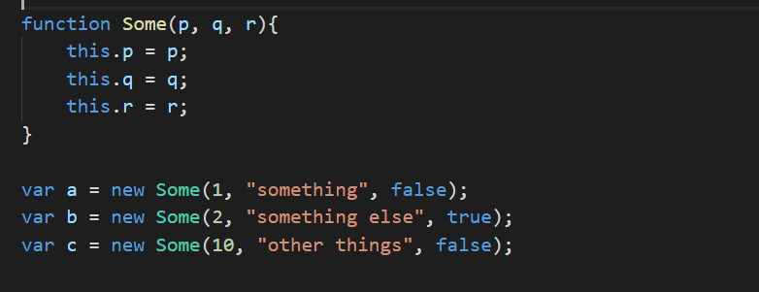
Create Class For Similar Objects

Slide 25
Demo – Using classes for objects

Slide 26
Avoid Using Delete
When using delete on an object :
JIT compiler invalidate the binary of the object’s class for this instance
JIT compiler treats the object separately from the class

Slide 27
Demo – Using Delete vs Using Undefined

Slide 28
Avoid Using Dynamic Properties
Dynamic property is a property that you add to the object on the fly.
When using it the same thing happens as in the delete operator example.

Slide 29
Arrays In Static Typed Languages
Continuous memory allocation
1000
1001
1002
1003
1004
1005

Slide 30
JavaScript Arrays
JavaScript Arrays can be of 2 types :
Continuous memory array
Hashmap array
Always make sure that you don’t create hashmap array, which are much less efficient

Slide 31
Use Typed Or Homogenous Arrays
ArrayBuffer and TypedArrays introduced in ES6.
If the array contains the same types, the JIT compiler will allocate continuous blocks of memory
Insertion and reading will become much faster
JIT compiler will recognise this for regular arrays

Slide 32
Demo – Typed Arrays vs Old Arrays Performance

Slide 33
Questions ?

Slide 34
Contact Me @
Tamar.twena@gmail.com
https://www.linkedin.com/in/tamarstern/
Twitter : @TwenaStern

